Slide 1
FAC 10 WebRTC Workshop
Peter Wilson, IpCortex

Slide 2
Making the web ‘real-time’
Audio calls, Video calls, Phone calls (via gateway)
Using ‘standard’ technologies
Vanilla browser
No proprietary plugins (Flash)
No proprietary protocols (Skype)
The standardised framework is WebRTC
Web Real Time Communication
Most browser are adopting this now

Slide 3
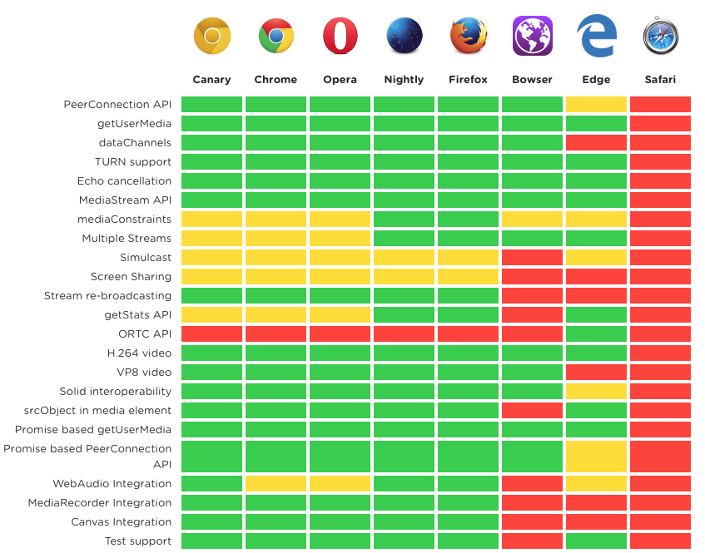
Is it all hype?

Slide 4
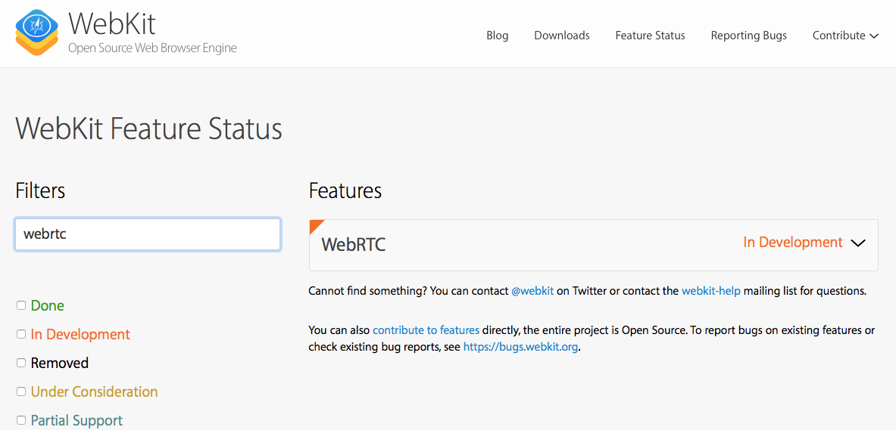
Apple Safari

Slide 5
Media Streams
Channels
MediaStream: Collection of Audio/Video Tracks MediaStreamTrack: One ‘device’ (eg camera, mic) Channel: Smallest Unit (left audio/ right audio)
Media Stream Track
Media Stream
https://developer.mozilla.org/en-US/docs/Web/API/Media_Streams_API

Slide 6
Media Stream
Unidirectional
Has one input and one output
Local inputs:
Microphone
Camera
RTCPeerConnection
Outputs:
<video> tag
RTCPeerConnection

Slide 7
Locally connecting media
Media Stream
<html>
<head>…</head>
<body>
…
<video></video>
</body>
</html>

Slide 8
Connecting between devices
Jim
Jane
RTCPeerConnection
webRTC
Media Stream
How do Jim and Jane find each other?
How is their traffic routed across the Internet through corporate firewalls?
How is permission asked to accept the call at the receiving end?

Slide 9
Signalling
“Signalling”
Jim
Jane
webRTC
Media Stream

Slide 10
Signalling
Allows two ends of an RTCPeerConnections to find each other
NOT standardised
Not necessary and much of this is application specific
Examples
IpCortex PABX – signalling, directory, presence and PSTN gateway (phone calls)
webRTC.io – one of the first libraries
Must be accessible to both parties
Provide a means of relaying information between the two parties
Should encrypt all communications
Usually a separate server

Slide 11
What is signalling used for?
Very simple WebRTC requirements
Transfer Javascript Objects between end points (eg serialised as JSON)
Send media ‘offers’ and ‘responses’ between end points
Swap communication ‘candidates’ between end points
Other signalling usually required for an application
End point discovery/name mapping (I’m Fred, I want to talk to Jane)
Presence (I’m Fred and I’m ‘online’)

Slide 12
Typical signalling exchange
Endpoint 1
Endpoint 2
Offer
SDP description
SDP description
Response
Candidate 1
Candidate 2
Candidate 1
Offers are sent as Session Description Protocol messages
Candidates give options for how to connect end points across a network
Accomplished via the Interactive Connectivity Establishment (ICE) framework
Multiple ‘candidates’ are tested concurrently with the first (fastest) used

Slide 13
Signalling Overhead
Intentionally very low overhead
Typically 24 exchanges per WebRTC session
~10K data exchanged
Many techniques available
REST Polling
HTTP ‘Long Poll’
REST to the signalling server/ EventSource distribution to clients
WebSocket bi-directional ‘pipes’
Only requires text transfer
Not just for setup though – media can change during a call

Slide 14
Workshop Objectives
Introduction to some key SW concepts
Classes and Objects
Finite State Machines
Promises
(not a key SW concept, but an unfortunate workaround for Node limitations)
Working with protocols (signalling)
Interoperability through protocols
Familiarisation with AV, webRTC concepts and browser API

Slide 15
Workshop – what we’re going to do…
Configure simple HTTPS server to serve scripts
Using streams locally
Create a <video> tag in a static page
Request media (camera and microphone)
Attach media to video tag
Local Peer Connection and Signalling
Connect multiple video tags together using webRTC
Local signalling layer
Remote peer-to-peer communication
Replace local signalling with a polled, remote signalling model
Node server to act as signalling relay
Network connections between each team’s implementations

Slide 16
Workshop materials
All materials available in GitHub
https://github.com/ipcortex/fac-workshop-materials
Background information in the GitHub Wiki
https://github.com/ipcortex/fac-workshop-materials/wiki

Slide 17
1. HTTPS server
Browsers only allow access to media and webRTC to ‘secure’ sites
Need an HTTPS server
To run an HTTPS server requires SSL certificates
“One I prepared earlier”
git@github.com:ipcortex/fac-workshop-materials.git
./fac-workshop-materials/https
Run with npm run https
Simple ‘Hello…’ message
Allow unsigned SSL certificate to see page
Basis for the rest of the workshop – build on this

Slide 18
Background - Promises
Replace ‘callbacks’ for asynchronous completion
Instead of…
http.get(‘http://server/mypage.html’, (res) => { // process response });
Use
http.get(‘http://server/mypage.html’) .then((res) => { // Process response });
Seems like a simple change but can reduce ‘callback hell’

Slide 19
’Callback Hell’
sqlExec(‘BEGIN’, (res) => { sqlExec(‘SELECT x FROM myTab’, (res) { sqlExec(‘INSERT INTO y(c1,c2) VALUES(res.v1, res.v2)’, (res) => { sqlExec(‘INSERT INTO z(c1,c2,c3) VALUES(res.v1, res.v4, res.v5)’, (res) => { sqlExec(‘COMMIT’); }) }); });
Instead:
sqlExec(‘BEGIN’) .then((res) => sqlExec(‘SELECT x FROM myTab’)) .then((res) => sqlExec(‘INSERT INTO y(c1,c2) VALUES(res.v1, res.v2)’) .then((res) => sqlExec(‘INSERT INTO z(c1,c2,c3) VALUES(res.v1, res.v4, res.v5)’) .then((res) => sqlExec(‘COMMIT’)) .catch((error) => console.error(’Something went wrong…’);

Slide 20
Building a Promise
Many standard HTML5 functions return Promise
Callback type functions can be easily wrapped
function myPromiseFun(params) { return new Promise((resolve, reject) ={ callOldSylyAsyncFn(params, (err, res) => { if (err!=null) // Appears to caller via ‘catch’ reject(err); else resolve(res); }); }

Slide 21
Classes/Object Orientated Design/Programming
Classes and objects are inherent features of Javascript
An object contains both state (data) and behaviour
State: position, mass, colour…
Behviour: changePosition, adjustColour
‘Class’ defines the attributes and behviours of all objects of that type
numberOfInstances
createInstance, findInstanceByName(‘operational’)
Inheritance or ‘specialisation’ allows one class to build on the foundations of another.

Slide 22
Classes and Objects in Javascript (ES6)
class Thing extends SimpleThing { construct(name) { this.name = name; this.colour = ‘TRANSPARENT’; Thing.register[name] = this; } static findInstance(name) { return Thing.register[name]; } setColour(newColour) { this.colour = newColour; } save() {…} }; Thing.register ={}; var myThing = new Thing(‘IDLE’); myThing.setColour(‘RED’);
‘this’ references the ‘current object’
Thing of the method as a ‘message’ and the object as the ‘address’

Slide 23
State Machines
Common SW mechanism for controlling flow
A ‘state machine’ exists in a single state
‘Events’ cause the state to change
Simple state machine:
incomingCall :reject
endCall
incomingCall
Waiting
Active
Connecting
makeCall
callAccepted
rejected

Slide 24
Workshop End Point State Machine
RINGING
Rx: CALL_REQUEST {send DECLINE}
START_CALL {send CALL_REQUEST}
Rx: ACCEPT_CALL
Rx: CALL_REQUEST {send DECLINE}
IDLE
Rs: DECLINE
CALLER
Rx: END_CALL
Rx: END_CALL
CALLED
Rx: CALL_REQUEST {send DECLINE}
Rx: CALL_REQUEST

Slide 25
2. Local stream
Request local media stream (video/audio)
Attach to browser <video> tag
<html>
<head>…</head>
<body>
…
<video></video>
</body>
</html>

Slide 26
2. Local media streams
var promise = navigator.mediaDevices.getUserMedia({ video: true, audio: true });
promise.then((avSteam) => { // Find my video tag… video = document.createElement('video');
video.srcObject = avStream; video.play(); // Add video tag to DOM videoContainer.append(v); }).catch(() => {…});
https://developer.mozilla.org/en-US/docs/Web/API/MediaDevices/getUserMedia

Slide 27
3. Local Peer Connection
<html>
<head>…</head>
<body>
…
<h2>Person 1</h2>
<video id=”person_1”></video> <button id=”Start Call”>Call</button>
<h2>Person 2</h2>
<video id=”person_2”></video> </body>
</html>
Connecting camera/mic to a local video tag THROUGH a peer connector
Implement our own local signalling
Shows the basic structure of how to connect streams to each other remotely without network complexity

Slide 28
3. Local signalling
Create a ‘signalling’ abstraction:
Announce(me), send(to), listen
Completely local
Single web page!
Announce(me)
Listen(msg)
Send(to)

Slide 29
3. Code structure and aims
Encapsulate the ‘signalling’ so it can be replaced
Implement a standard set of messages
Each team will interoperate with all other team’s implementation
EndPoint base class – encapsulates the means of communication
VideoEndPoint derived class – implements webRTC a/v sharing
Skeleton in:
EndPoint class: https/assets/comms.js
VirtualEndPoint class: https/assets/caller.js

Slide 30
3. Steps to local AV calls
Building on the skeleton files in git/https:
assets/comms.js, caller.js and driver.js
Add send/receive messaging to EndPoint class
Implement a ‘receive()’ method in VideoEndPoint class
Create two instances of VideoEndPoint and send a message between them
Create DOM->Javascript video call code
‘address’ field, call button, status field, 2x<video> tags for them and me.
Hook button to JS onclick
On ‘call’ send CALL_REQUEST to target address
Show state changes of caller and called end points in console and in HTML
Add webRTC video streaming to established calls

Slide 31
3. Example HTML for ONE video caller
<div class="col-xs-12 col-md-6" id='V4’> <h2>Party 4: <span class="state">IDLE</span> </h2> <button class="pause">Pause</button> <!-– onclick handler for this ends a call --> <button class="endCall">Hangup</button> <!-– Somewhere to type the target address – who I want to call --> <input type="text" name="target" class="target" placeholder="Enter recipient call name"> <!-– onclick handler for this trys to make a call to the name in the text field --> <button class="startCall">Call</button> <!– Video tags included here but not used until the next stage --> <video class="remoteVideo"></video> <video class="localVideo"></video> </div>

Slide 32
3. Steps to start/end calls
Write HTML for 4 ‘virtual’ callers
4 video tags showing person called + 4 small video tags showing local video
<input type=“text’> to enter the name of the person to call
Display the current state (in HTML)
For each caller, create a VideoEndPoint object
Pass in the video tags and the ‘status’ display tag to the constructor new VideoEndPoint( ‘name’,remoteVideoDOMtag, localVideoDOMtag, statusDOMtag )
Add ‘click’ event handlers for ‘call’
Add these into ‘driver.js’
When ‘call’ button clicked:
Work out who the caller is (who clicked call) – find the VideoEndPoint object
Get the value from the ‘target’ field
Send ‘CALL_REQUEST’ to the target

Slide 33
3. State Machine first steps…
Add a setState(newState) method to VideoEndPoint
Use this to update the state DOM element you added to the constructor
Add a method to VideoEndPoint to implement ‘CALL_REQUEST’
And call that from the switch statement in ‘receive’
Make a call and check the states of the two end points involved

Slide 34
Referencing VideoEndPoints
Each of the instance methods in VideoEndPoint has a ‘this’
Refers to the object that is the subject of the current request.
In the *current* task all EndPoints are on one computer. It can be tempting to do:
class VideoEndPoint { receive(from,operation,params) { … this.doSomething(); var fromObj = find_the_from_object(from); fromObj.doSomethingElse(…) } }

Slide 35
Responsive HTML layout
<div class=”container”> <div class=“row”> <div class=”col-xs-12 col-sm-6”> … </div> <div class=”col-xs-12 col-sm-6”> … </div> <div class=”col-xs-12 col-sm-6”> … </div> <div class=”col-xs-12 col-sm-6”> … </div> </div> <div>

Slide 36
A trick with Promises
promiseFunction().then((result) => doSomething);

Slide 37
A trick with Promises
promiseFunction().then((result) => doSomething); but the Promise can also be saved and be used many times: this.myPromise = promiseFunction(); this.myPromise.then((result) => {doFirstThing}); …
this.myPromise.then((result) => {doAnotherThing});
Use this where a value that may take a time to resolve is needed in multiple places

Slide 38
Connecting between devices
Jim
Jane
RTCPeerConnection
webRTC
Media Stream
How do Jim and Jane find each other?
How is their traffic routed across the Internet through corporate firewalls?
How is permission asked to accept the call at the receiving end?
https://www.html5rocks.com/en/tutorials/webrtc/infrastructure/

Slide 39
RTCPeerConnection
Remote Stream
v
Attach Stream
onaddstream “I have a new incoming stream for you to deal with”
onicecandidate “I have an ICE candidate I need you to send for me”

Slide 40
RTCPeerConnection Events
There are ‘two’ events that can happen which need to be processed
The connection wants to send an ICE candidate
Listen for these with the onicecandidate callback function
When one happens send it the the other end of the call
The connection receives an AV stream from the remote end
Listen for these by adding an onaddstream callback to the connection
When one happens, take the stream and attach it to the <video> tag

Slide 41
Adding video to the demo
Don’t create a RTCPeerConnection until you have access to media
Get the media in the VideoEndPoint constructor
Call getUserMedia()
When that Promise resolves attach the stream to the local <video> tag
Keep hold of the Promise returned from getUserMedia

Slide 42
Asynchronous Completion: Promise Trick
CALL_REQUEST -> CreatePeerConnector SendOffer
getUserMedia() // 1. <- ACCEPT_CALL getUserMedia() // 2. // 1.
.then((media) => attachToLocalVideoTag; // 2. .then((media) => { createPeerConnection() attachLocalMedia() setRemoteDescription() createAndSendAnswer() }

Slide 43
Using RTCPeerConnection objects
CALLER (wait for getUserMedia AND THEN):
Create a Peer Connection when call accepted
Get local media (as you did for a video tag)
Attach media to the Peer Connection
Create an SDP Offer to send to the remote end
Close the Peer Connection at the end of the call
CALLED (wait for getUserMedia AND THEN):
Create a Peer Connection when accepting a call
Get local media (as you did for a video tag)
Attach media to the Peer Connection
Wait for an SDP Offer to arrive
Create an SDP Answer
Close the Peer Connection at the end of the call

Slide 44
Creating an RTCPeerConnection
// NOW get the media stream and don’t do anything else until it’s attached to the connection waitForUserMedia(options).then((localStream) => { var pc = new RTCPeerConnection; pc.onicecandidate = (ev) => { // Send to REMOTE end point } pc.onaddstream = (remoteStream) => { // Attach this stream to the <video> tag }
// Got the LOCAL stream. Add it the the peer connection… pc.addStream(localStream); });

Slide 45
Connecting video to the call
Similar to ‘getUserMedia’ and then attach to <video> tag
Instead ’getUserMedia’ and then attach to Peer Connection
To do this – we need a Peer Connection:
Caller: create Peer Connection when call is accepted
Called: create Peer Connection when accepting a call
https://www.html5rocks.com/en/tutorials/webrtc/infrastructure/

Slide 46
4. Remote Peer Connections
Replace local signalling with node server proxy.
Options for transferring signalling:
AJAX Poller
Web Socket
NODE SERVER
Jim
Jane
webRTC
Media Stream

Slide 47
4. Signalling across a network
Split your signalling into two parts:
Carry information across the local network
Modify the application to have one end point per browser
Announce(me)
Listen(msg)
Send(to)

Slide 48
4. Signalling across a network (2)
If you’ve implemented part 3 well then
All you should have to do to the client/browser is rewrite EndPoint
There should be no changes required to VideoEndPoint
Extend the node server to implement the REST interface
Specified in the WIKI

Slide 49
5. Talking between teams
There should be 4 teams with working clients and node servers
The node servers are implementing a defined protocol
So…
The client from any team should be able to talk to any node server
Two clients from two different teams should be able to connect to the same node server and make a call
AIM:
Using any teams node server
Connect clients from all 4 teams to that server and make a call

Slide 50
5. Cross team
Team 1 Client
Team 4 Client
webRTC AV Call
Node Signalling Server (Team 1)
Team 2 Client
Signalling
webRTC AV Call
Team 3 Client
Team 3 Client

Slide 51
6. Remote Presentations
Presentation Server
1. Announce Presentation
2. Join Presentation
4. Send A/V Real time Stream
3. Negotiate session
Signalling Server
3. Negotiate session
Signalling: EITHER using IpCortex api OR modified signalling from previous task

Slide 52
Signalling for Remote Presentations: Two Options
Evolution of simple signalling from previous example
Should work on a local LAN
Won’t work across the Internet without TURN/STUN servers (complexity)
IPCortex API
Covers all the routing across the Internet
More complex to configure/run

Slide 53
References
mediaDevices.getUserMedia MDN:
https://developer.mozilla.org/en-US/docs/Web/API/MediaDevices/getUserMedia
WebRTC
https://developer.mozilla.org/en-US/docs/Web/API/WebRTC_API
WebRTC.org – Getting Started
https://webrtc.org/start/
HTML 5 Rocks – Getting started with WebRTC (2012)
Illustrates local signalling but not is a portable way
https://www.html5rocks.com/en/tutorials/webrtc/basics/
HTML 5 Rocks – WebRTC Infrastructure
Great overview of signalling – everything you need to know!
https://www.html5rocks.com/en/tutorials/webrtc/infrastructure/
adapter.js: https://github.com/webrtc/adapter
Shim to isolate applications from browser incompatibilities
Promises:
https://kosamari.com/notes/the-promise-of-a-burger-party
https://developer.mozilla.org/en/docs/Web/JavaScript/Reference/Global_Objects/Promise
Classes/OOD/OOP: https://developer.mozilla.org/en-US/docs/Learn/JavaScript/Objects/Object-oriented_JS
Finite State Machine: https://developer.mozilla.org/en-US/docs/Glossary/State_machine

Slide 54
adapter.js https://github.com/webrtc/adapter

Slide 55
RTCPeerConnection
var pc new RTCPeerConnection(); pc.onicecandidate = (e) => { this.send(from, "CANDIDATE", e.candidate); }; pc.onaddstream = (e) => { attachMediaStream(videoTag,e.stream); videoTag.play(); }
localMediaPromise.then((mediaStream) => { pc.addStream(mediaStream); console.log('PeerConnector (TX) createOffer start'); var offerOptions = {offerToReceiveAudio: 1, offerToReceiveVideo: 1}; pc.createOffer(offerOptions) .then((offer) => { console.log("WE HAVE AN OFFER...",offer); // Give the offer description to our end of the connector pc.setLocalDescription(offer); // Send the offer to the remote end of the peer connector this.send(from, "SDP_OFFER", offer ); }); // Attach this stream to a video tag... attachMediaStream(videoTag, mediaStream); // And set the 'play' state for this tag. videoTag.play(); });

Slide 56
RTCPeerConnection – incoming signalling
function receivedIncomingSDPoffer(from, data) { this.data.pc.setRemoteDescription(data); // And generate an answering offer this.data.pc.createAnswer().then( (desc) => { this.data.pc.setLocalDescription(desc); // And send this to desciption to the remote end this.send(from, "SDP_ANSWER", desc); }); } } function receivedIncomingSDPanswer(from, data) { this.data.pc.setRemoteDescription(data); } function receivedCandidate(from, data) { var candidate = new RTCIceCandidate(data); this.data.pc.addIceCandidate(candidate); }

